Slide 1

High Impact ISO Standards
Jennifer Admussen
September 22, 2025

Slide 2
High Impact Standards
ISO 19011
ISO 14001
ISO 9000
ISO 9001

Slide 3
ISO 19011
Title: ISO 19011 Guidelines for auditing management systems
Last revised: 2018
Current stage: DIS (Draft International Standard)
Expected Publication Date: 2026 Q1
Popularity: 12th most popular standard worldwide
Audience: auditors, organizations with ISO management system certifications, consultants

Slide 4
ISO 14001
Title: ISO 14001 Environmental management systems – Requirement with guidance for use
Last revised: 2015
Current stage: DIS (Draft International Standard)
Expected Publication Date: 2026 Q1
Popularity: 4th most popular standard worldwide
Audience: organizations with ISO 14001 certification, auditors, consultants, organizations following ISO 14001

Slide 5
ISO 9000
Title: ISO 9000 Quality management systems – Fundamentals and vocabulary
Last revised: 2015
Current stage: DIS (Draft International Standard)
Expected Publication Date: 2026 Q1
Popularity: 20th most popular standard worldwide
Audience: Organizations certifying to ISO 9001, users of standards in TC176 family

Slide 6
ISO 9001
Title: ISO 9001 Quality management systems - Requirements
Last revised: 2015
Current stage: DIS (Draft International Standard)
Expected Publication Date: 2026-09
Popularity: most popular standard worldwide
Audience: organizations certified to ISO 9001, consultants, auditors, organizations following ISO 9001
Public comment link (open until Oct. 25, 2025: https://asq.org/quality-resources/iso-dis-9001-public-comments

Slide 7
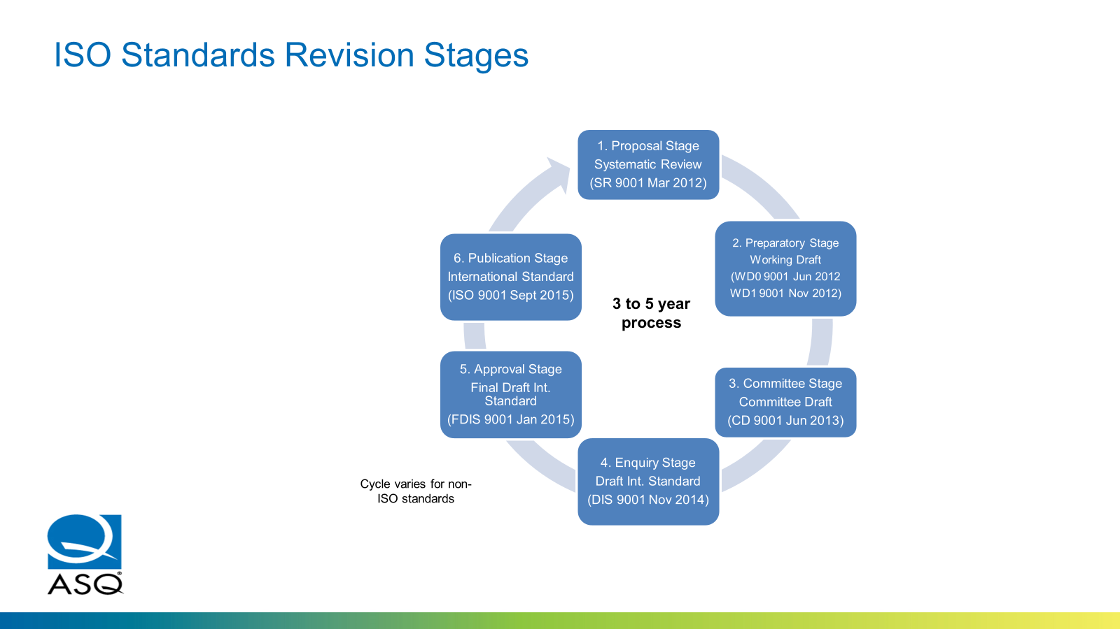

Slide 8
Thank You

